Slide 1
Introduction

Slide 2
Contents
Introduction & ECMAScript
Fundamentals
Adding script
Variables
Strict mode
Data types
typeof, Type Conversion
Interaction(alert, confirm, prompt)
Basic Operators
Loops & switch

Slide 3
Introduction
Created by Netscape.
Initially named as Livescript but based on java it renamed as Javascript.
Browser has own JS virtual machine.
V8 - chrome and Opera
Spidermonkey - firefox
Chakra - IE
Language over Javascript:
Typescript - Microsoft
Flow - FB
By NodeJS we can make js run on server instead of browser.

Slide 4
ECMAScript
JavaScript is a scripting language that confirms to the ECMAScript specification.
ECMAScript specification is a blueprint for creating a scripting language. JavaScript is an implementation of that blueprint.
ECMAScript versions have been abbreviated to ES1, ES2, ES3, ES5, and ES6(2015)[Let, const introduced etc].
Since 2016 new versions are named by year (ECMAScript 2016 / 2017 / 2018).

Slide 5
Fundamentals

Slide 6
How to add scripts:
Inline: <script> console.log(“hai”); </script>
External: <script src=”filename”></script>

Slide 7
Variables
Undeclared Variable [this. will work]
Var ( function scope ) [this. will work]
Const ( block scope )
Let ( block scope ) Possible names : Num_hits, temp99, $credit, _name can start with _ or $, cannot start with numbers, can only contain alphanumeric or underscore, should not contain space, should not use reserve words.

Slide 8
console.log(b); var b=5; // undefined | console.log(b); const b=5; // b is not defined | console.log(b); let b=5; // b is not defined
b=5; var b; console.log(b); // 5 | b=5; let b; console.log(b); // Cannot access 'b' before initialization | b=5; const b; console.log(b); //Missing initializer in const declaration
var x=1; if(x==1){ var x=2; console.log(x); } console.log(x); //2 //2 | let x=1; if(x==1){ let x=2; console.log(x); } console.log(x); //2 //1 | const x=1; if(x==1){ const x=2; console.log(x); } console.log(x); //2 //1
let x=1; { var x=2; } //Identifier 'x' has already been declared | let x=1; { let x=2; } // no error block scope | let x=1; { const x=2; } // no error

Slide 9
var a=1; var b=2; if(a==1){ var a=11; let b=22; console.log(a); //11 console.log(b); //22 } console.log(a); //11 console.log(b); //2 | var a=1; (function(){ var a=4; console.log(a) })(); console.log(a); // 4 // 1
const foo; //Missing initializer in const declaration | let x=5; x=2; //2

Slide 10
Strict Mode
It is a way to opt in to a restricted variant of JavaScript.
“use strict” is to indicate that the code should be executed in "strict mode".
Always should be on the top of the script.
num=0; (undeclared variable error)
let a=0; (redeclaring throw error) let a=0;
let a=b=c=0 (throw error)

Slide 11
Datatypes
String
Number
Undefined
Null
Boolean
BigInt
Symbol
Object (Reference Datatype)

Slide 12
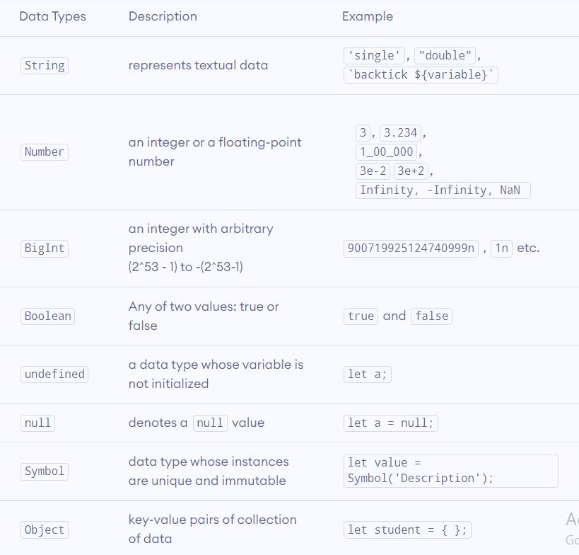

Slide 13
NOTES:
Numberic other Forms :
0x – hexadecimal, 0b – binary, 0o - octal
Symbol:
A “symbol” represents a unique identifier.
Symbol() === Symbol() // false because unique;
Symbols are not included in for...in Loop
let id = Symbol(“data"); // id = symbol, description = “data“
id.toString(); // "Symbol(data)“
id.description; //"data"

Slide 14
~practice~ Numeric Forms
`2+3 = ${2+3}` // 2+3 = 5
(1/0) // Infinity
(-1/0) // -Infinity
(“a”/5) // NaN
let lakh = 100000; // 100000
let lakh = 1_00_000; // 100000
let lakh = 1e5; // 100000
1e-1 // 0.1
1e-3 //0.001
11e2 //1100
1.1e2 //110

Slide 15
Type Conversion
There are two types of type conversion in JavaScript.
Explicit Conversion - manual type conversion
Number(), String(), Boolean()
Implicit Conversion - automatic type conversion
‘4’ – 1 //3

Slide 16
Explicit Conversion
String Conversion: (typeof String(false)) // string //false becomes "false", //null becomes "null“,
String(object) //"[object Object]"
Numeric Conversion: undefined, string - NaN null, false, empty-string - 0 true - 1 string : whitespaces from both sides are ignored.
Boolean Conversion:
0, an empty string, null, undefined, and NaN, become false Other values become true.

Slide 17
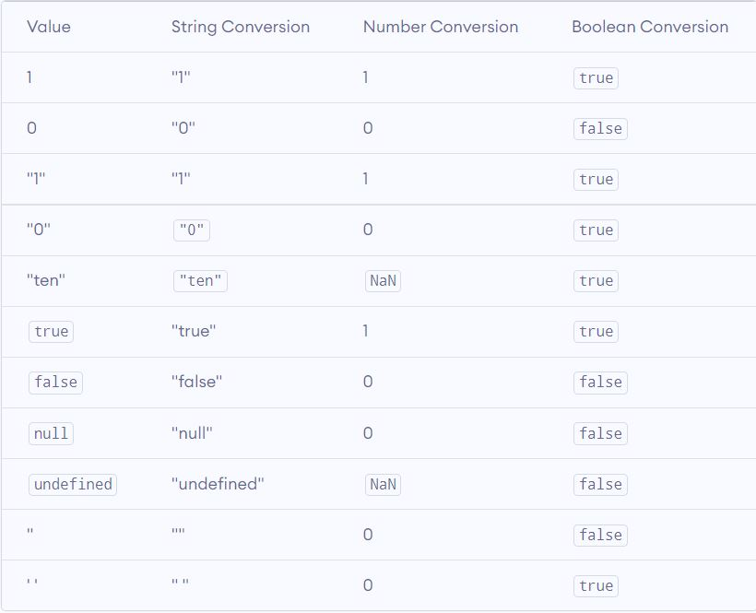

Slide 18
~practice~ String()
String(“”) // ”’”
String(12) //”12”
String(undefined); //”undefined”
String(null); //”null”
String(NaN); //”NaN”
let b = function(){}; String(b); //"function(){}“
let obj = {name:"hai"}; String(obj); //"[object Object]"

Slide 19
~practice~ Number()
Number(12); //12
Number("12"); //12
Number(“ 1 ”) //1
Number(“ ”) // 0
Number(false) //0
Number(“ 1z”) // NaN
Number(“ 1 1 ”) // NaN
Number(NaN); // NaN
Number(undefined); //NaN
"[object Object]"

Slide 20
Implicit Conversion
Numeric string with + gives string but with -, /, * convert to number type.
Non numeric string with -, /, * and undefined gives NaN
For Boolean value true-1, false-0
null is 0 when used with number

Slide 21
~practice~ Implicit Conversion
"" + 2 + 2 // “22"
"" - 1 + 0 // -1
true + false // 1
6 / "3" // 2
"2" * "3" // 6
4 + 5 + "px" // "9px"
"$" + 4 + 5 // "$45"
"4" - 2 // 2
"4px" - 2 // NaN
" -9 " + 5 // " -9 5"
" -9 " - 5 // -14
null + 1 // 1
undefined + 1 // NaN
" \t \n" – 2 // -2

Slide 22
~practice~ Typeof
As an operator: typeof x
As an function: typeof(x)
typeof undefined // "undefined“
typeof 0 // "number“
typeof 10n // "bigint“
typeof true // "boolean"
typeof "foo" // "string"
typeof Symbol("id") // "symbol"
typeof Math // "object" (1)
typeof null // "object" (2)
typeof alert // “
Typeof {}; // objectfunctio
Typeof []; //object;n" (3)

Slide 23
Basic Operators
Arithmetic Operators
Assignment Operators
Increment/ Decrement Operators
Bitwise Operator
Comparison operator
Logical operators

Slide 24
Arithmetic Operator
(+) [string concatenation] “hello” + “hai” [numeric conversion] ~practice~ It actually does the same thing as Number(...) example: “2” + “3” // “23” +”2” + +”3” // 5 +true // 1 +”” //0
(-, *, /, %, **) 4 ** (1/2) // square root 4 ** 2 // square of

Slide 25
Assignment Operator
All operators in JavaScript return a value. ~practice~
let a = 1;
let b = 2;
let c = 3 - (a = b + 1);
alert( a ); // 3 alert( c ); // 0
Shorthand
n *=4
n +=3;

Slide 26
let counter = 2; counter++; alert( counter ); // 3 | let counter = 2; counter--; alert( counter ); // 1 | let counter = 2; ++counter; alert( counter ); // 3 | let counter = 2; --counter; alert( counter ); // 1
let counter = 2; let a = ++counter; alert( a ); // 3 | let counter = 2; let a = counter++; alert( a ); // 2 | let counter = 0; counter++; ++counter; alert( counter ); //2 | let a = 1, let b = 1; let c = ++a; let d = b++; // a = 2 // b = 2 // c = 2 // d = 1
let counter = 0; alert( ++counter ); // 1 | let counter = 0; alert( counter++ ); // 0
let i = 0; while (++i < 5) alert( i ); // from 1 to 4 | let i = 0; while (i++ < 5) alert( i ); // from 1 to 5 | for (let i = 0; i < 5; i++) alert( i ); // from 0 to 4 | for (let i = 0; i < 5; ++i) alert( i ); // from 0 to 4

Slide 27
Bitwise Operator
AND &
OR |
XOR ^
NOT ~
LEFT SHIFT <<
RIGHT SHIFT >>
ZERO-FILL RIGHT SHIFT >>>

Slide 28
Comparison Operator
>
<
>=
<=
==
===
!=

Slide 29
Comparison with diff. types
String Comparison:
strings are compared letter-by-letter.
alert( 'Z' > 'A' ); // true
alert( 'Glow' > 'Glee' ); // true
alert( 'Bee' > 'Be' ); // true
With Different types:
When comparing values of different types, JavaScript converts the values to numbers.
alert( '2' > 1 ); // true,
alert( '01' == 1 ); // true,

Slide 30
Strict Equality ===
A regular equality check == has a problem. It cannot differentiate 0 from false.
alert( 0 == false ); // true, alert( ‘’ == false ); //true,
alert( null == undefined ); //true
After:
alert( 0 === false ); // false, alert( ‘’ === false ); // false,
alert( null === undefined ); // false

Slide 31
~practice~ Comparision
5 > 4 → true
"apple" > "pineapple" → false
"2" > "12" → true
undefined == null → true
undefined === null → false
null == "\n0\n" → false
+null == 0 → true

Slide 32
Logical operators
|| OR, && AND, ! NOT, ?? Nullish Coalescing.
OR “||” finds the truthy value
AND “&&” finds the falsy value
!NOT
A double NOT !! used for converting a value to boolean type
?? will check null or undefined
JavaScript forbids using ?? together with && and ||

Slide 33
~practice~ Logical operator
alert( null || 2 || undefined ); //2
alert( undefined || null || 0 ); //0
alert( 1 && null && 2 ); //null
alert( 1 && 0 ); //0
alert( !true ); // false
alert( !0 ); // true
alert( !!"non-empty string" ); // true
alert( !!null ); // false
(null ?? "Anonymous"); // “Anonymous”
(“john” ?? "Anonymous"); //”john”
let x = 1 && 2 ?? 3; // Syntax error
let x = (1 && 2) ?? 3; //2 Works

Slide 34
Loops
while
do-while
for
for-in
for-of
switch
break/continue (should not use right side of ?)
While(true), for(;;){} makes infinite loop

Slide 35
Break/continue using label
outer: for (let i = 0; i < 3; i++) {
inner: for (let j = 0; j < 3; j++)
{
let input = prompt(`Value at coords (${i},${j})`, ‘’);
if (!input) break outer;
}
} alert('Done!');

Slide 36
Switch
let arg = “1”;
switch (+arg) {
case '0’:
case 1: alert( 'One or zero’ );break;
case 2+3: alert( 'Two' ); break;
case 3: alert( 'Never executes!' ); break;
default: alert( 'An unknown value' );
}

Slide 37
Reference
https://javascript.info/
https://www.programiz.com/javascript/get-started

